Slide 1
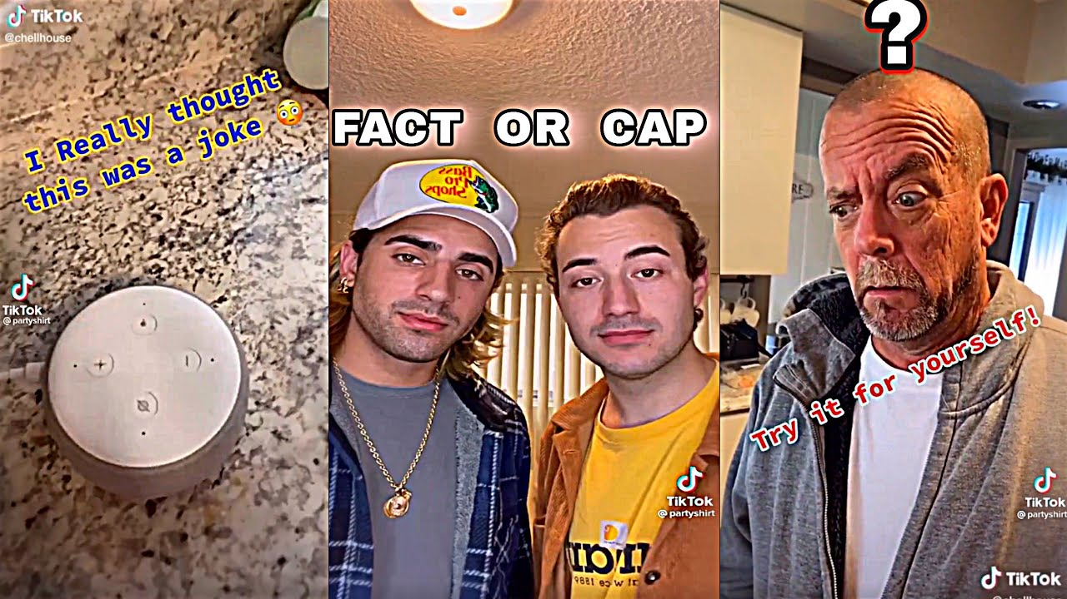
FACT or CAP

Slide 2
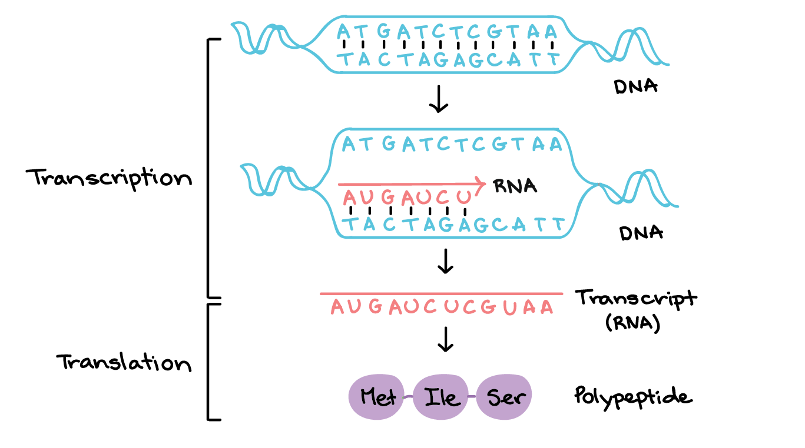
#1 FACT or CAP?!?!?
Transcription occurs in the nucleolus of cells.

Slide 3
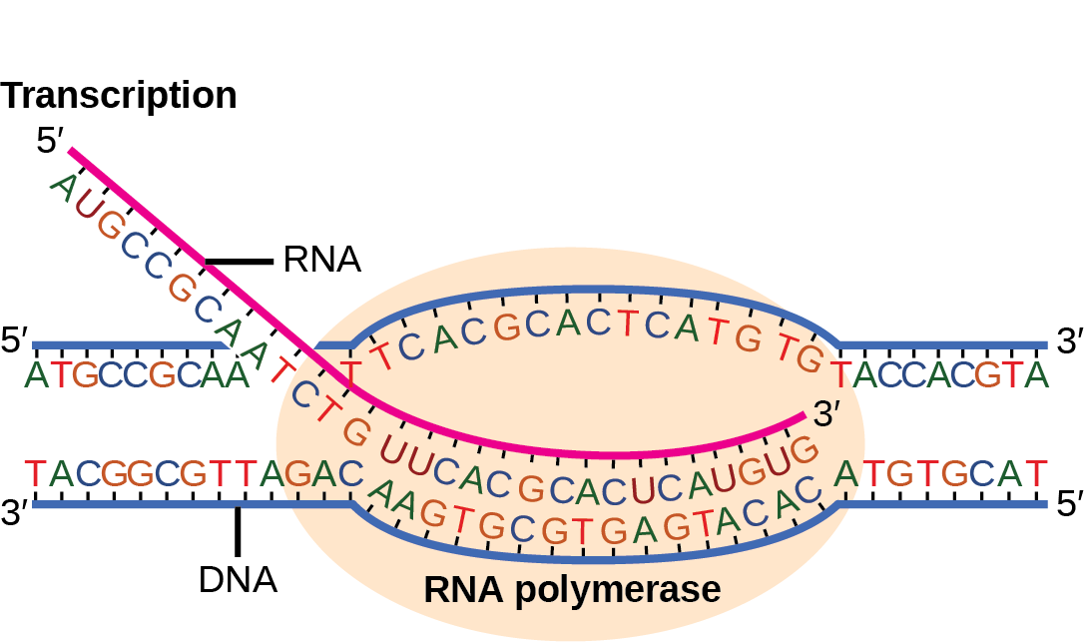
#2 FACT or CAP?!?!?
Transcription involves DNA, mRNA, and Ribosomes.

Slide 4
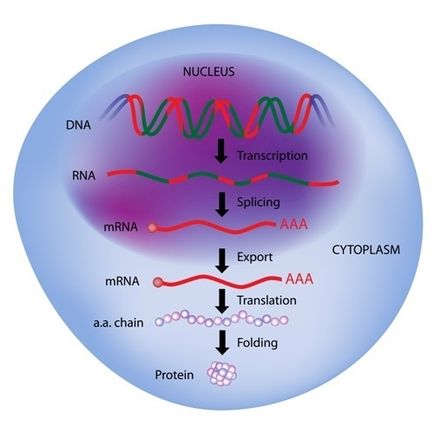
#3 FACT or CAP?!?!?
Translation occurs in the nucleus and cytoplasm of cells

Slide 5
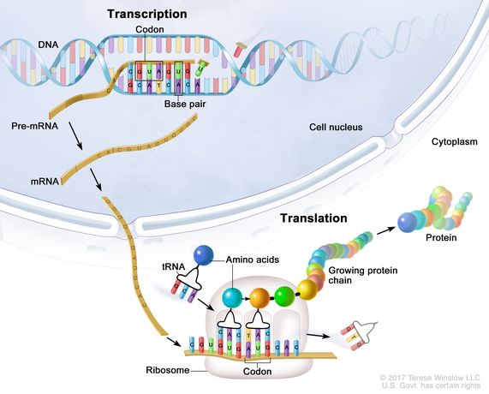
#4 FACT or CAP?!?!?
Translation involves DNA, mRNA, tRNA, and rRNA

Slide 6
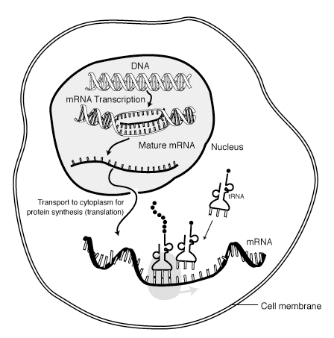
#5 FACT or CAP?!?!?
The process of protein synthesis is important for binding amino acids together to create a polypeptide chain (protein).

Slide 7
Make a Case

Slide 8
Question 1

Slide 9
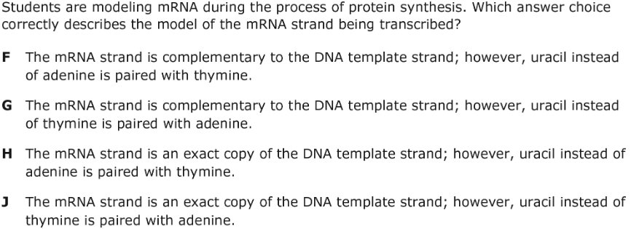
Question 2

Slide 10
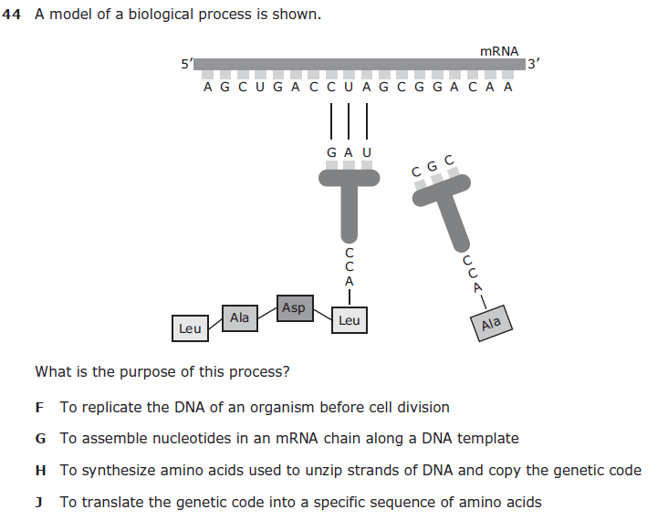
Question 3

Slide 11
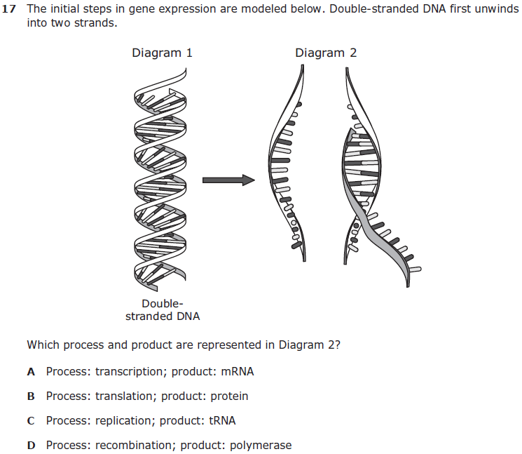
Question 4

Slide 12
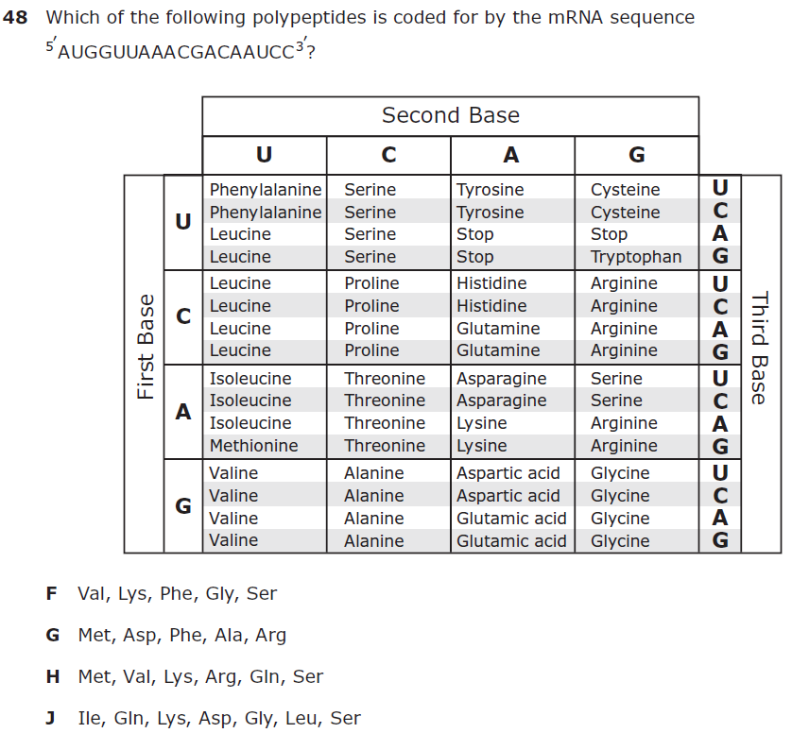
Question 5

Slide 13
Slap Down Game

Slide 14
Question 1

Slide 15
Question 2

Slide 16
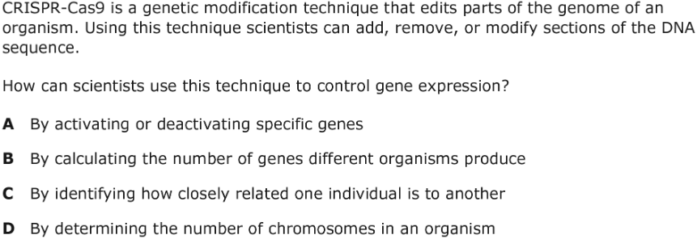
Question 3

Slide 17
Question 4

Slide 18
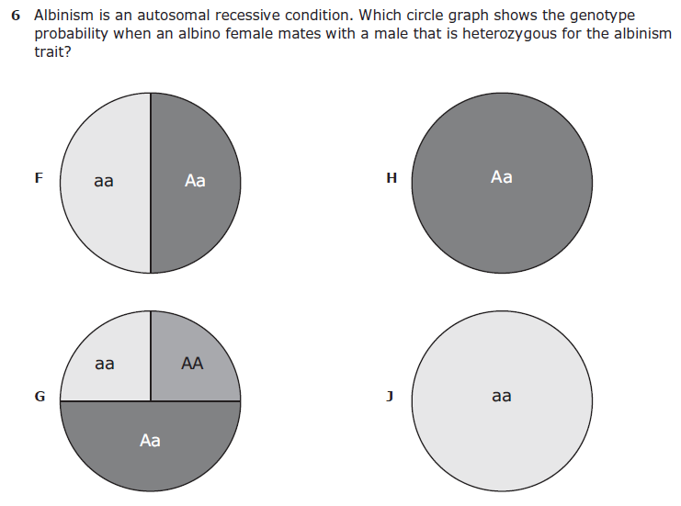
Question 5

